Slide 1

THEORY OF MECHANISMS AND MACHINES BME (III/II)
Prepared by :
Bipin Tiwari
Assistant Lecturer
Thapathali Campus, IOE, TU

Slide 2
Gear Trains
Two or more gears are made to mesh with each other to transmit power from one shaft to another.
It is also called train of a toothed gears.
It depends on:
On the velocity ratio
The relative position of the axes of the shafts.
It may consist of spur, bevel or spiral gears.

Slide 3
Types of Gear Trains
Depending upon the arrangement of the wheels:
Simple gear train,
Compound gear train,
Reverted gear train,
Epicyclic gear train.
In first three types axes of the shaft over which the gears are mounted are fixed relative to each other.

Slide 4
Contd…
In case of epicyclic gear trains, the axes of the shaft on which the gears are mounted move relative to a fixed axis.

Slide 5
Simple Gear Train
When there is only one gear in the shaft then it is known as simple gear train.
Gears are represented by their pitch circles.

Slide 6
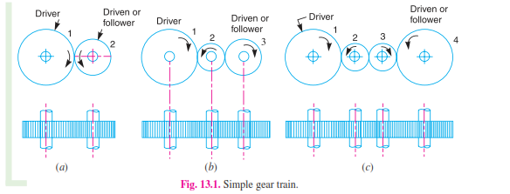
Contd…
Simple gear trains for transmission of motion when the distance between the shafts is small.

Slide 7

Contd…
Gear 1 is driver.
Gear 2 is driven or follower.

Slide 8


Contd…
Speed ratio = Driver by follower
Train Value = Follower by driver

Slide 9
Contd…
If the distance between the two gears is large then what could be the solution??

Slide 10
Contd…
The following two methods could be the solution:
By providing large sized gear.
By using one or more intermediate gears.
Which is one more efficient??

Slide 11
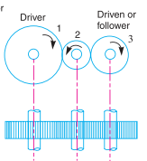
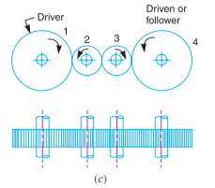
Contd…
Large size gear more uneconomical and inconvenient one.

Slide 12
Contd…
One is odd and another is even.
In odd configuration same directional motion
In even configuration it is opposite directional motion.

Slide 13

Contd…
For fig b

Slide 14
Contd…
These intermediate gears acts as a idle gears.
Basically for two functions:
To connect gears when large center distance is required.
To obtain the desired direction of motion of the driven gear. ( CW or CCW)

Slide 15
Compound Gear Train
When there are more than one gear on a shaft , it is called a compound train of gear.
To bridge the gap and also when great/much less speed ratio is required.

Slide 16
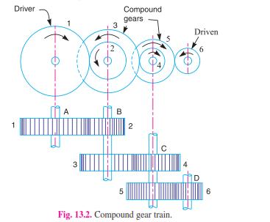
Contd…
Compound Gear

Slide 17


Contd…
Let,
= ??

Slide 18


Contd…
We have,

Slide 19
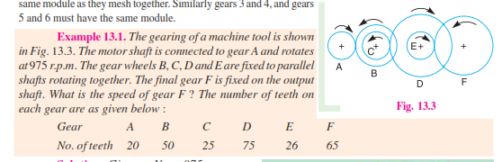
Contd…
Q.

Slide 20

Contd…
Soln.

Slide 21
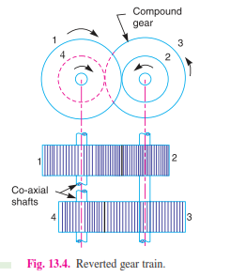
Reverted Gear Train
It is the condition when the axes of the first gear and last gear are co-axial .

Slide 22
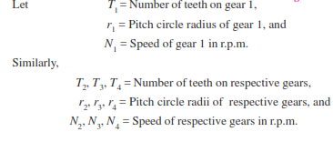
Contd…
Let,

Slide 23
Contd…
Distance between the center of shafts between gears 1 and 2 as well as 3 and 4.
From above relation we can obtain

Slide 24



Contd…
We have,
Note:

Slide 25

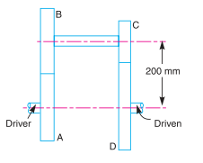
Contd…
Q.

Slide 26
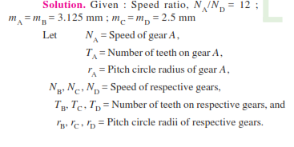
Contd…
Soln

Slide 27
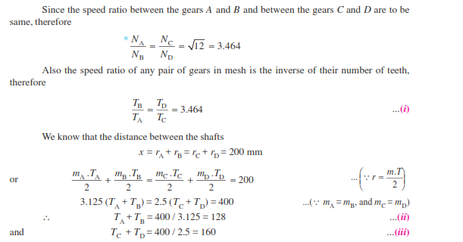
Contd…
Soln

Slide 28
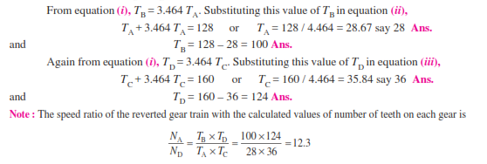
Contd…
Soln

Slide 29
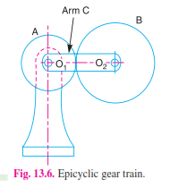
Epicyclic Gear Train

Slide 30
To Be Continue
Thank You!!!

